Slide 1
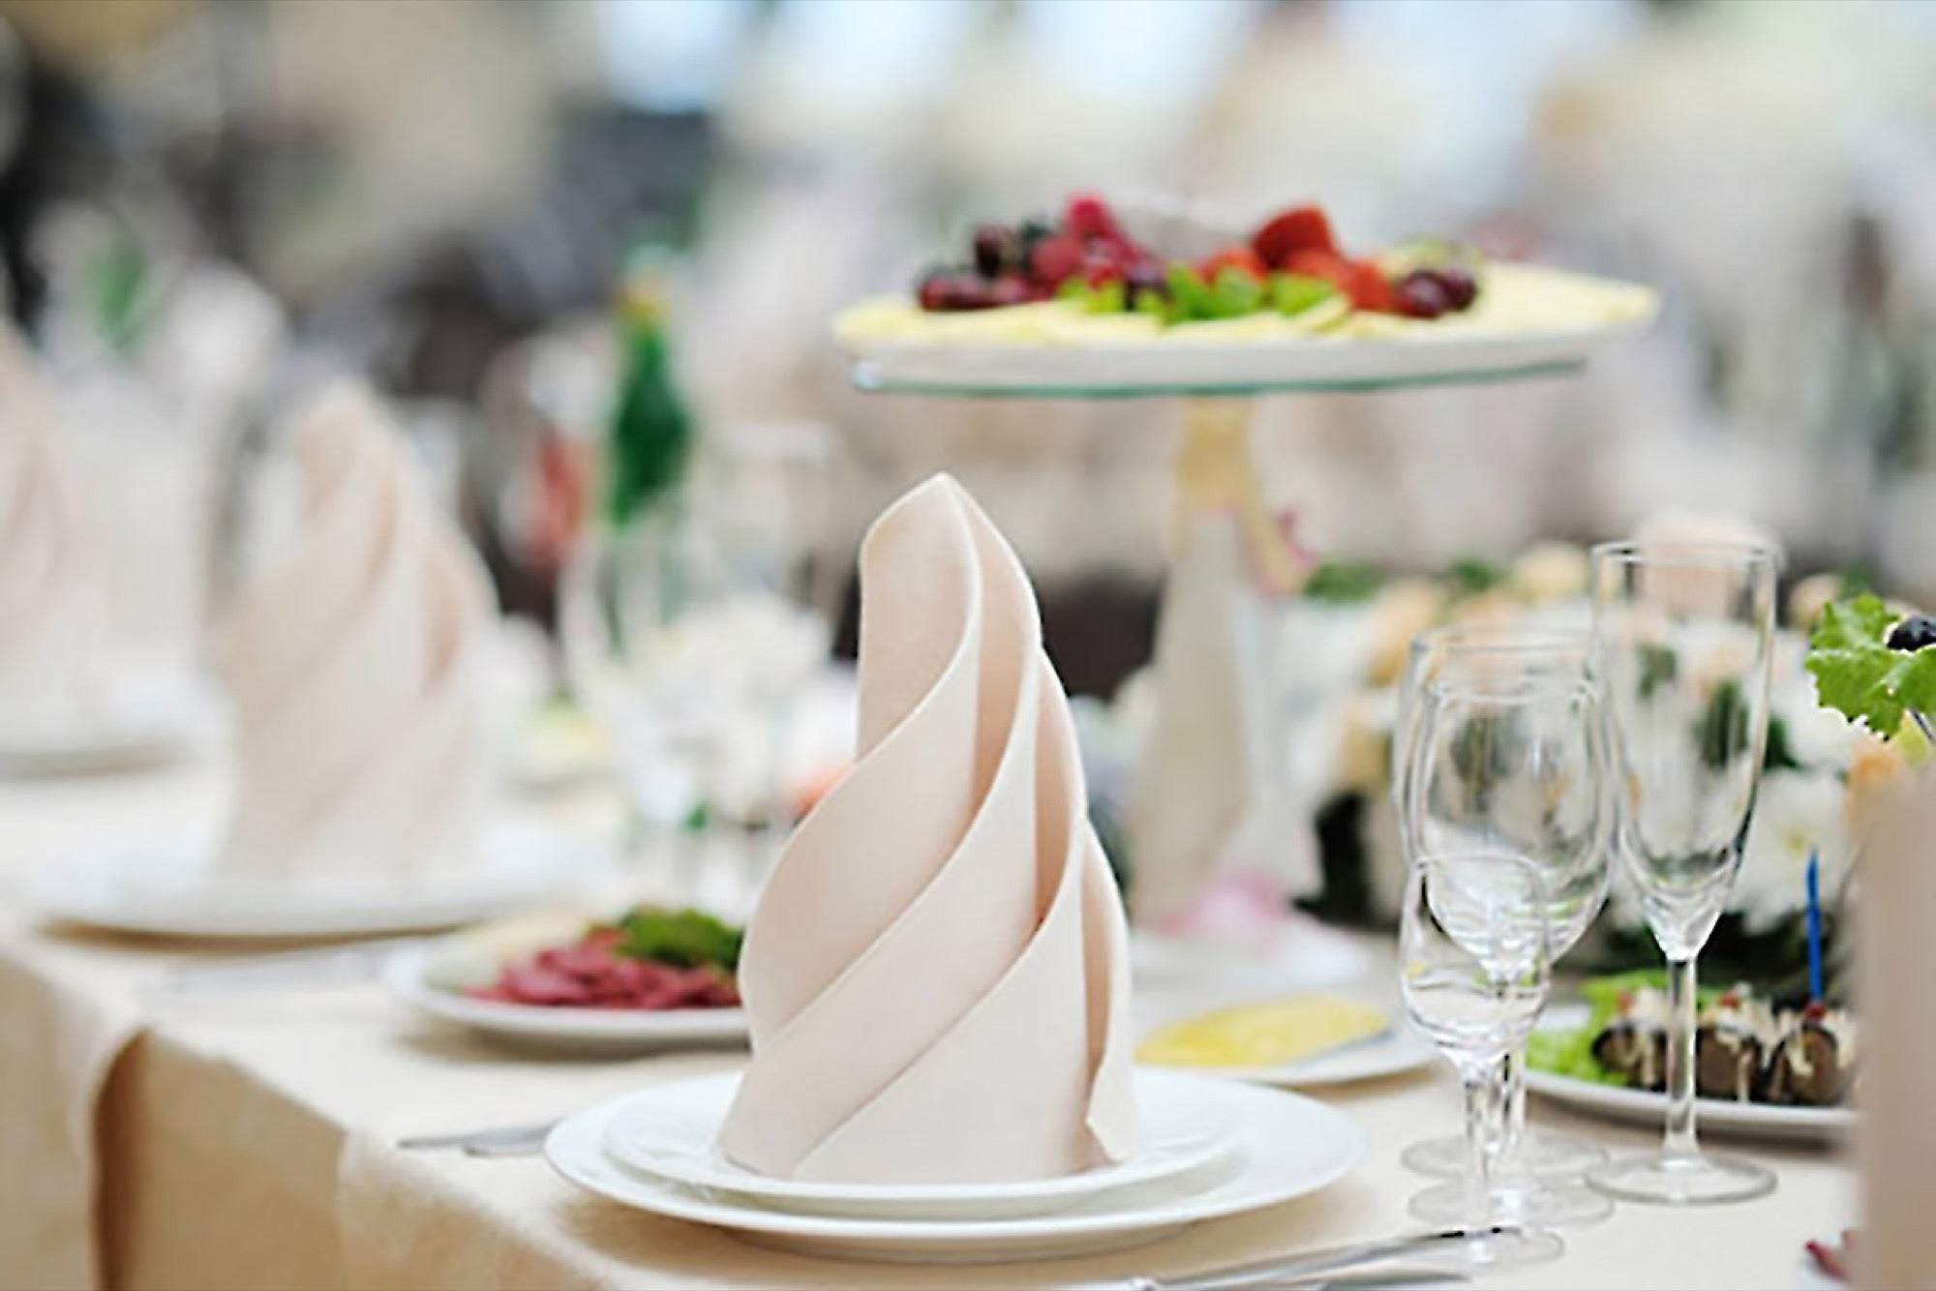
EVENT MANAGEMENT
TEAM MEMBERS:
MOHIT SUDHAKAR
SIRISHA R
RISHABH SINGH N
ROSVIN JOSEPH C

Slide 2
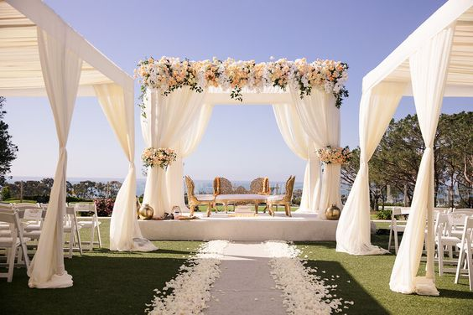

EventMC
Our website provides the privilege of managing various events tailored according to the needs of the customer.
We as a team consists of well trained personel , trained according to the needs and events of our customers.
The website is user friendly and provides facilities for various events from baby showers to bridal showers. You are just a call away...

Slide 3

Services We Offer
One platform, many services – a customer bliss indeed…
Services we provide:
1.Conference event
2.Weddings
3.Baby shower
4.Birthday
5.Stage decorations
6.Customized events*

Slide 4


Customized Events
Our special service includes customized events , where we take in the needs and wants of the customer and tailor the event according to their preference and according to the occasion.

Slide 5

Registration Made Easy
Hassel free registration with atmost clarity. Our team ensures that every customer feels involved in the process for better understanding between the client and the server.
Client to worker communication is enabled right after registration in order to keep our service on point as per the customer requirements.

Slide 6

Customer satisfaction is our main goal. Aiding to their thoughts in order to make the moment last forever and after is our priority.
Thank you.
EventMC

